Slide 1
Newham black history month 2018-2022
Cllrs Seyi Akiwowo & James Beckles
Thursday 26th October 2017

Slide 2
WHAT IS UK BHM ? & WHY IS IT IMPORTANT?
Origins from Negro Week in the US 1926
UK BHM 1987 – 30 years this year
Celebrating and commemorating the achievements, contributions of black people and hardships suffered
Notes:
origins of Black History and its intended purpose, for those that don’t knowmuch about its roots, BHM started as Negro History week in America in 1926 by Carter G. Woodson then expanded it to a month in 1976 and was officially recognized by U.S Government.The President at the time, Gerald Ford spoke in regards to this, urging Americans to &quot;seize theopportunity to honour the too-often neglected accomplishments of black Americans in every area ofendeavour throughout our history.Some years later Black History Month was adopted here in the UK and first celebrated in 1987.

Slide 3
WHY WE SHOULD REACTIVATE NBM
26.83% of Newham residents identify as Black or Black British
Newham Equalities and Cohesion
Embed within our programmes i.e. every child a reader -
Community resilience framework
Cultural bid
Senior figures recognise BHM Mayor of London, Jeremy Corby and Theresa May
Heritage Week is different
Holocaust Mermoral Day-
Political and the public mood music, lesson learnt from Winiefred School
Notes:
“Black History Month gives us an opportunity to celebrate the huge contribution black people have made and continue to make. This history is not simply a ‘black story’, but a British story.”

Slide 4
WHAT CAN WE DO
Good examples of Local Authorities hosting BHM
Link to Barking & Dagenham’s video about BHM - https://youtu.be/i94eMT_xvDo
Newham is already an outlier
Hackney Council not just a month but a season, Tower Hamlets launched a series of activities, exhibitions and events, Waltham Forest showcase, comedy night, cinema screening
Even Sutton Council, small black population – BHM – on their website and publising through comms - Mayoral by-in and appearance at events
Only other council that does not celebrate BHM is Wandsworth Council
Notes:
James

Slide 5
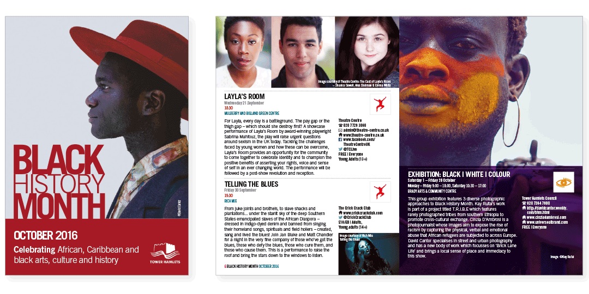
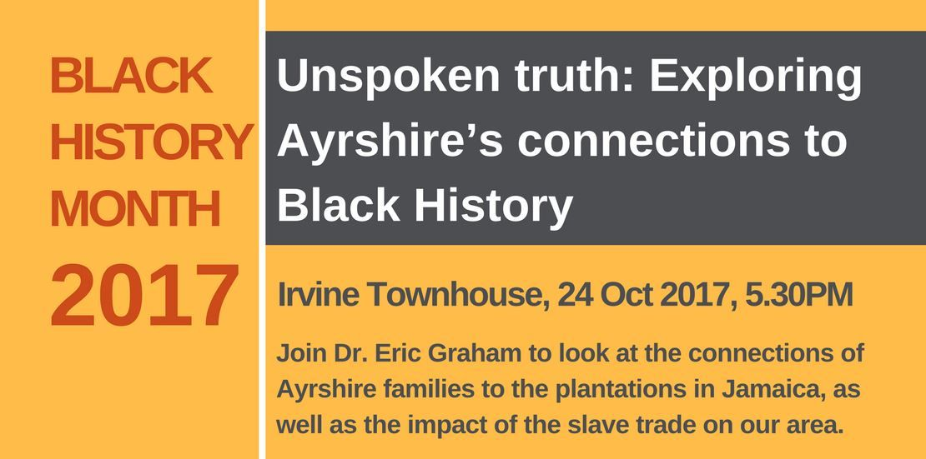
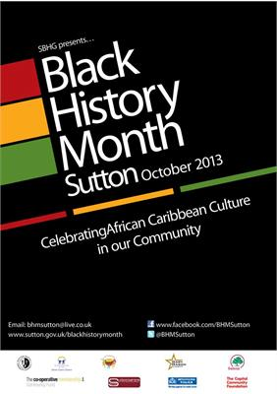

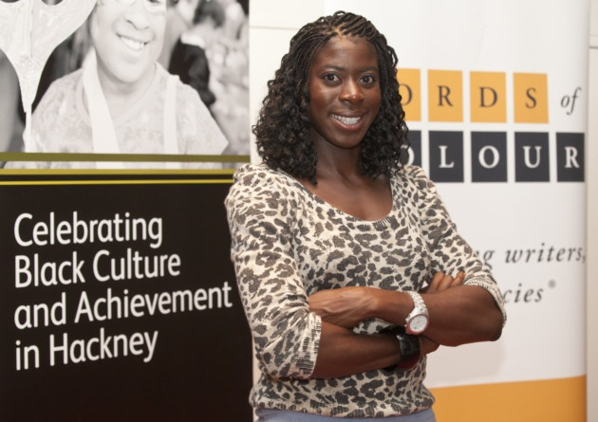

Slide 6
INITIAL STRATEGY PLAN
Year 1- A New Will
Year 2- Building
Year 3- Growth

Slide 7
YEAR 1 - A New Will
Utilising LGTPS – case example Manchester Council
Newham Council Comms promotion
Newham Libraries & Newham Library cinemas night
Newham Community markets promoting BHM and Black business/ traders
Exhibitions i.e Newham Archives, and UEL Black Diaspora
Utilising talents, resources and connections in Newham i.e. Working closer with UEL, Birbeck, Newham Bookshop, Strattford Circus, Stratford Theatre, PictureHouse
Council leadership attending BHM events- raising profile
Signing up to a NBH Group – case example Sutton Council
Developing a framework/ guidance/ best practice for schools
Facilitating community resilience i.e. promotion and providing discounted facilities
Notes:
Seyi
LGTPS – Manchester Council – IWD- 2 month advance + supporting voluntary with the use of community space to meet, celebrate
Comms promotion, acknowledge on website, Newham Mag
Libraries- BH section, signing posting black authors, investing diverse books i.e. Reni’s Why I’m No Longer Talking to White People About Race
Newham Library cinemas night- one central location to celebrate BHM, a black director, two black actors from Newham
Community markets promoting BHM
Exhibition area- of Newham Archives, and Black Dispoa- UEL
Utilising talents, resources and connections in Newham i.e. Working closer with partners like UEL, Birbeck, Newham Bookshop, Strattford Circus, Stratford Theatre, PictureHouse
Council leadership attending BHM events- raising profile, leadership
Signing up to a NBH Group (i.e. Sutton)
Framework/guidance/ best practice for Schools but ensuring this is community led
Facilities, promotion, facilitate

Slide 8
YEAR 2 - BUILDING
Continuation for year 1 based on evaluation of activity
Launch of NBH Group, at least one councillor non-exec sit on the panel.
Official launch of BHM by the council, full programme outlining events and activities taking place in Newham over the month.
Funding call out – to run BHM events (i.e. Southwark Council )
Investing in Newham Archives to update its research on black history and contributions of local communities - collection of written and oral history (ie Eastside Community Heritage)
Call outs for events - plays, activities, exhibitions; these can be done outside of October
Notes:
James

Slide 9
YEAR 3- 5 GROWTH
Continuation of Year 1 & 2
Putting Newham back on the map
Newham Black History Season (Hackney)
funding call out – to run council led BHM event (i.e. Southwark Council )
Newham Volunteers used to promote BHM- especially Newham Black History
Black History 365 days work outside the council
Wider equalities strategy discussion/frameworking, building references groups
Notes:
Seyi

Slide 10
MOVING FORWARD- JAMES
Finalise the NBHM 5 year plan – discussion point for working group
Governance - meetings, minuted and transparent with updates to residents and members
Terms of Reference (TOR), aims and deliverable objectives and officer support
Recognition of our contribution to the working group
And a motion to BHM – providing leadership, a framework to facilitate and generate activity
A calendar of equality days to be kept and day/Month recognised on the council website
Notes:
James

